Slide 1
Power Core PCA Assembly Instructions Item Name: Power Core PCA Part number: 701-00012 Doc Revision: 2

Slide 2
History Log
1) Revision 1 - Initial Release
2) Revision 2 – Clarified final location of the transformer wire to facilitate future assembly steps

Slide 3
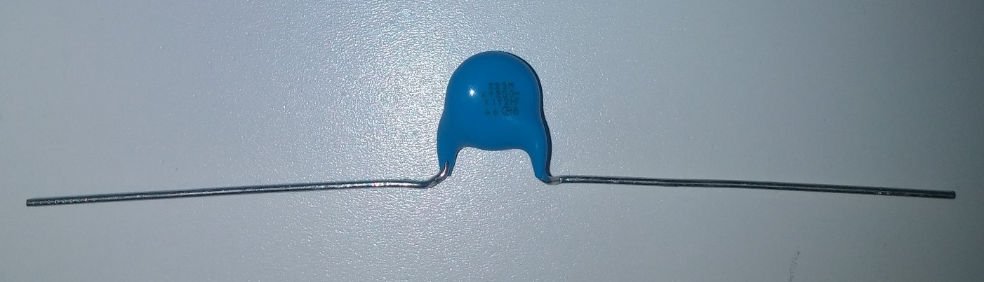
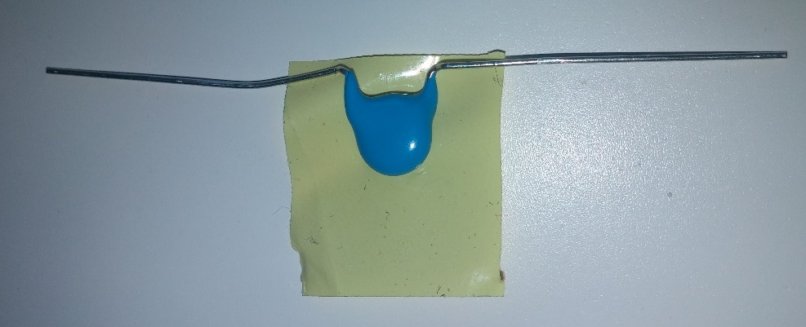
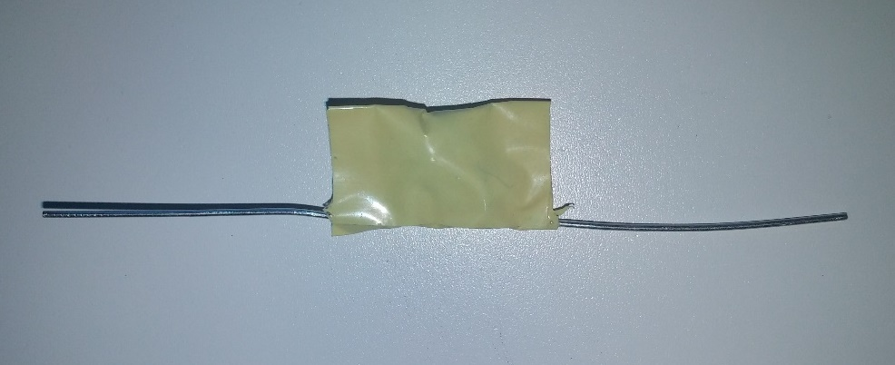
Take the new capacitor C3, 101-00028 rev B
Bend the leads out as close to the cap body as possible
Add 3 layers of tape,
103-00003 rev A
20 mm
18 mm
Note: AC mains wires are not shown in this presentation

Slide 4
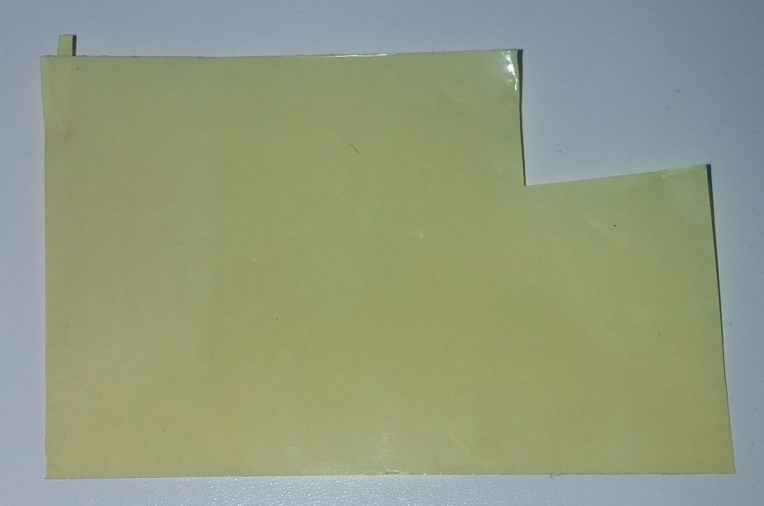
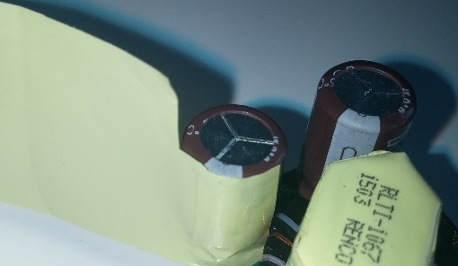
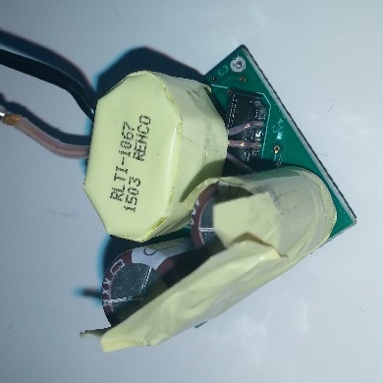
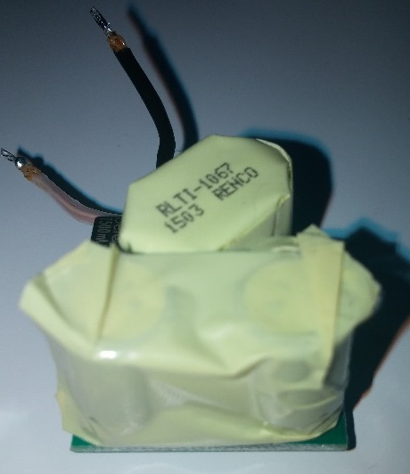
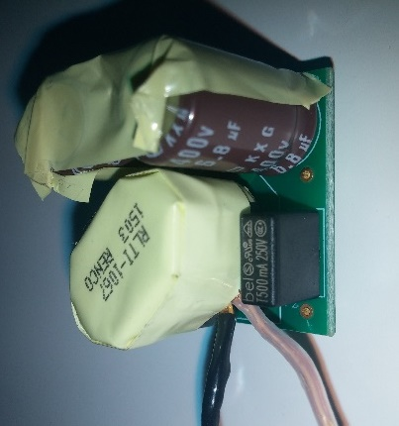
Take the Power Core Primary PCA, 701-00008 rev D
Precut the tape
Add 3 layers of tape,
103-00003 rev A
30 mm
10 mm
9 mm
25 mm
Start between cap and transformer
Non-adhesive side
16 mm
40 mm
Keep this cap side uninsulated for easier fit in the housing
Note: AC mains wires are not shown in this presentation
Cover the cap tops completely

Slide 5
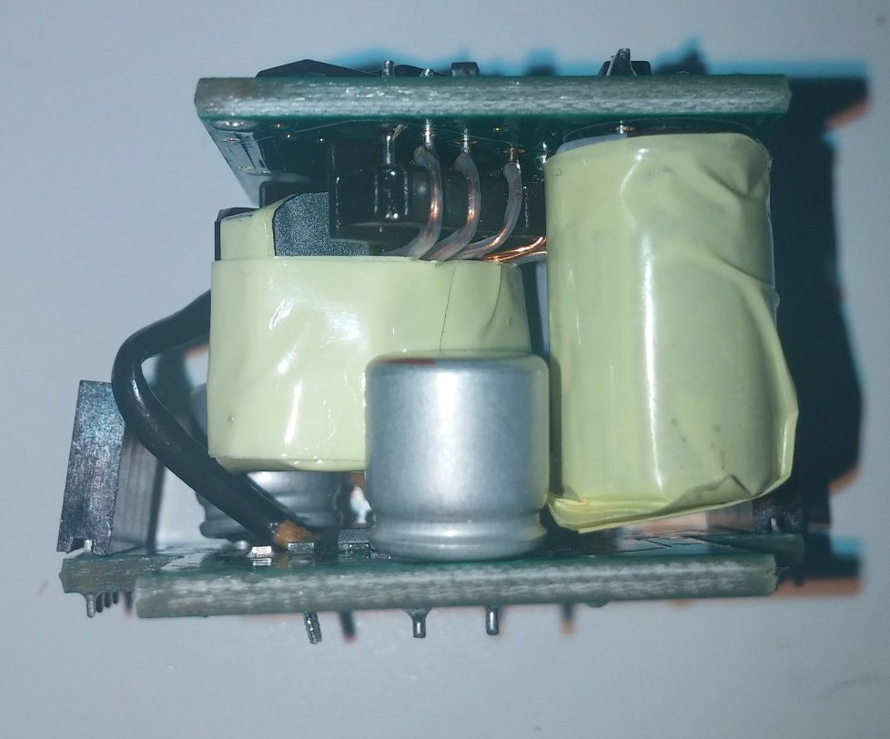
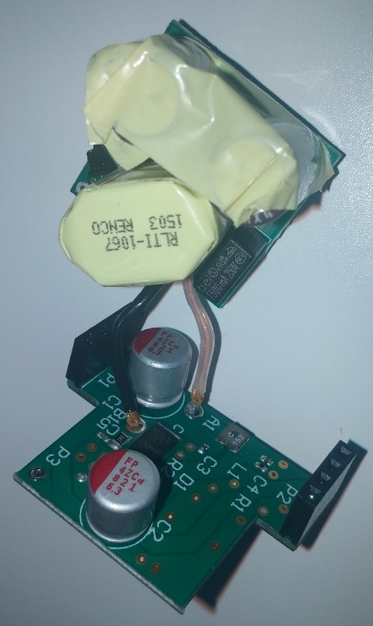
Take the Power Core Secondary PCA, 701-00013 rev C
Solder transformer secondary leads to the secondary board
Note: AC mains wires are not shown in this presentation

Slide 6
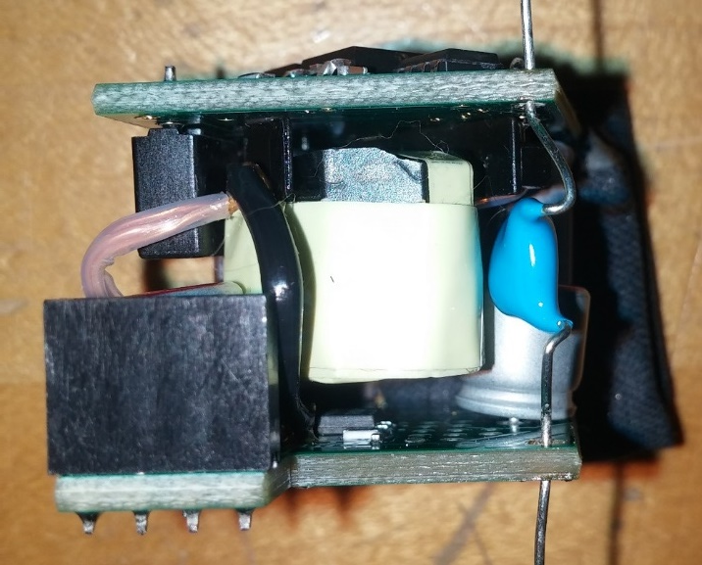
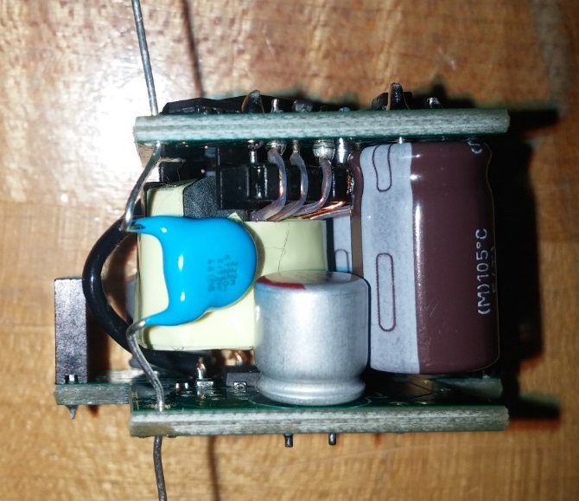
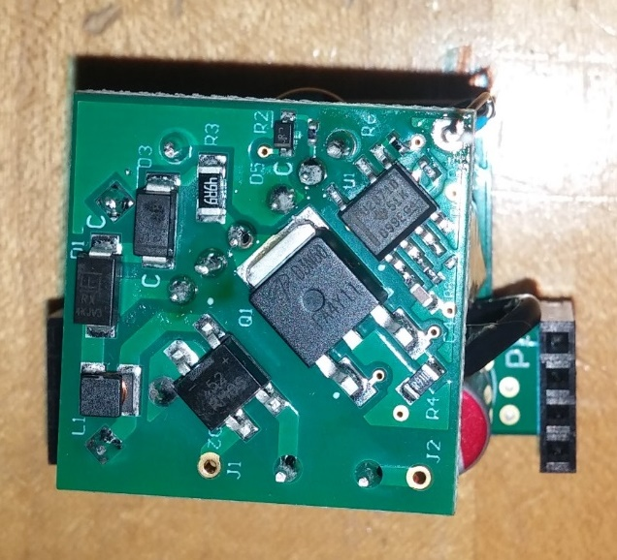
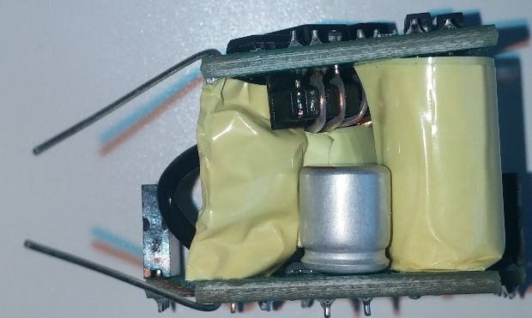
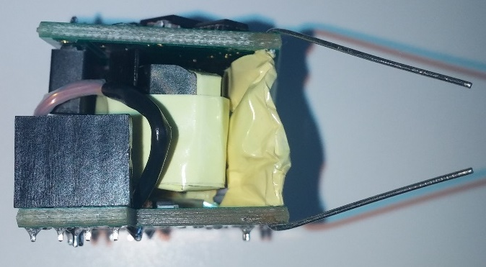
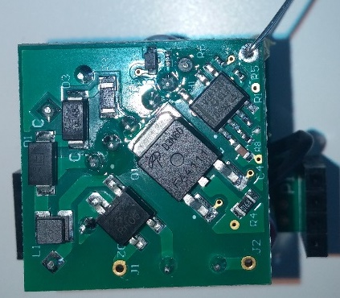
Place insulated capacitor C3, 101-00028 rev B
Uninsulated view
Uninsulated view
Uninsulated view
Insulated view
Insulated view
Insulated view
Orient the capacitor toward the middle of the power core, so that it doesn’t stick out
Note: AC mains wires are not shown in this presentation

Slide 7
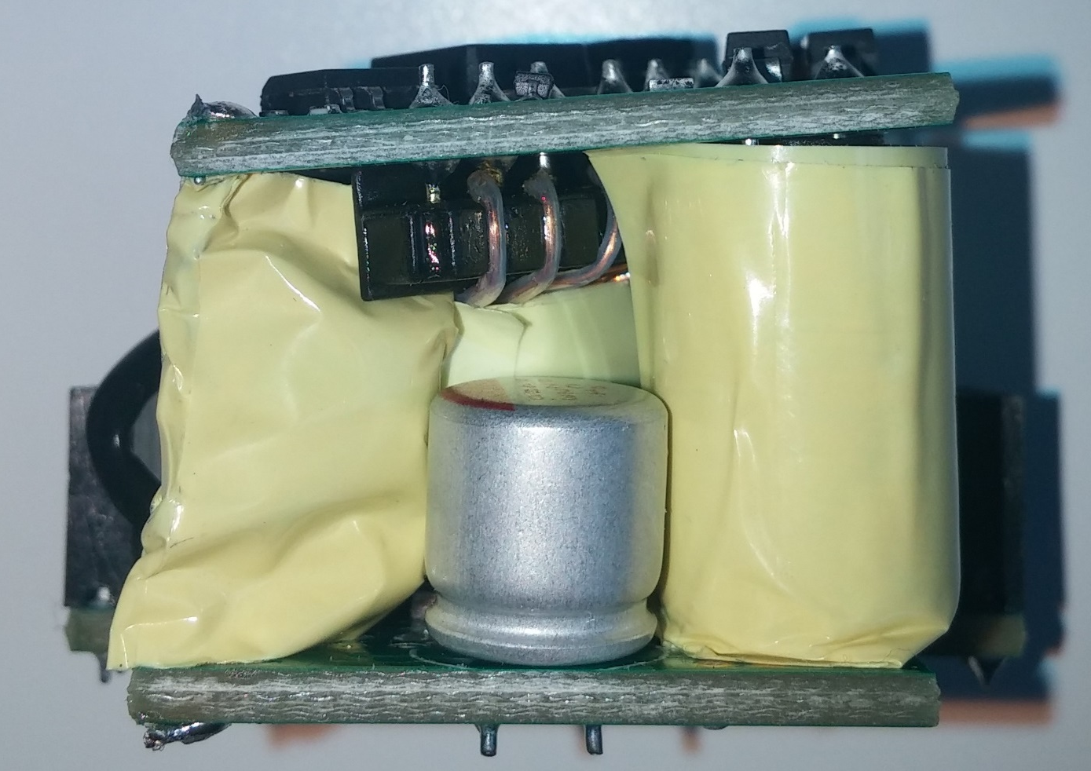
Solder and trim the capacitor C3 leads
Note: AC mains wires are not shown in this presentation

Slide 8
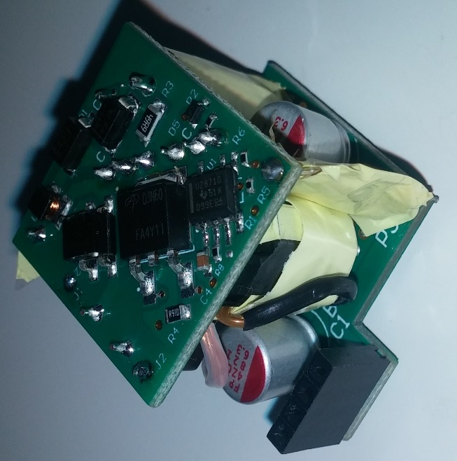
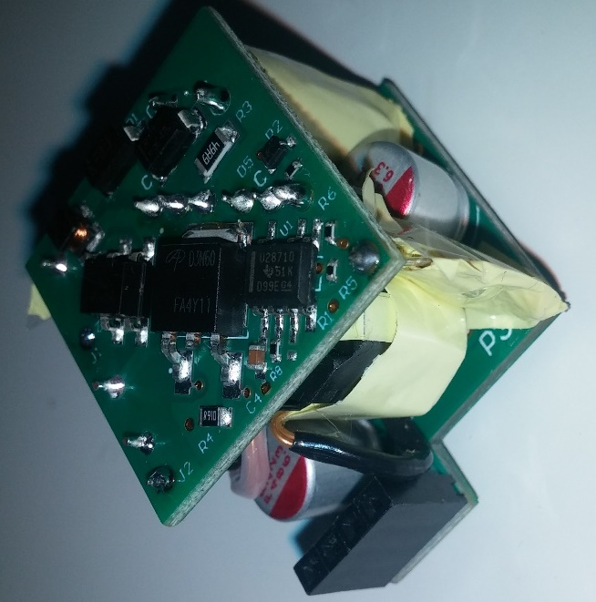
Move transformer secondary wire, B1, closer to the power core PCA body
Good
Bad
Note: AC mains wires are not shown in this presentation

